Slide 1

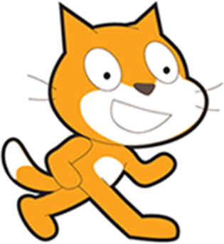
Beginner’s Session 10/16/2013
Time to do some programming
scratch.mit.edu
Inspiring examples
http://scratch.mit.edu/studios/246979
CoderDojo October Studio
http://scratch.mit.edu/studios/261917/

Slide 2
Whoa, programming?
But, but, but..
So, can computers think?
(no)
Ok, can they be told what to do?
(psst, yes, and it’s called programming!)
Can they make decisions?
(yes)
How? We’ll dive into this today.
Notes:
Purple is my hint to you
Red is when I think you’re concerned

Slide 3
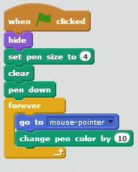

5 minute Project!
“Rainbow Writing” demo of advanced version
Your mouse is the pen.
Make the writing follow the mouse.

Slide 4
Tonight (and beyond): Batty-Pong! (Ask yourself: “How can I use what he’s saying to write the game”)
First stages
A Bat flies around the stage
You guard the bottom from the bat
If the bat gets past you: GAME OVER
Later: the bat scores
Think about tricks for detecting that the player missed the bat? (Already solved my challenges? Find a second way to do it!)
(The trick I’m using is to have a line of a unique color,
and test if the bat touches that color.)

Slide 5
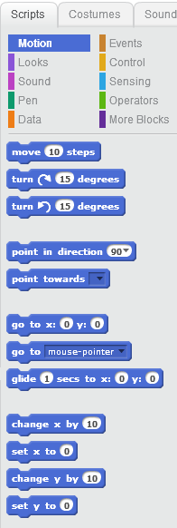
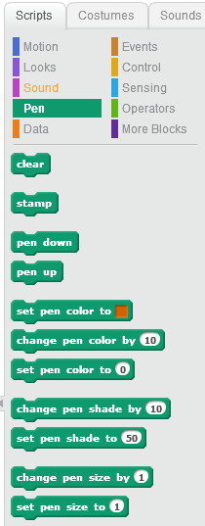
What can computers be told to do?
If you’ve used Scratch, you know some script types
Drawing
Motion
Scratch Logo Demo
The next few slides show some of the other important script blocks.

Slide 6
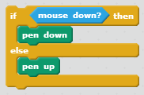
Computers is so stoopid!
Don’t do what I said, do what I want!!
They take action on events or the result of decisions in tests
In Rainbow Writer, you probably wanted the pen to stop writing, but how?
I decided to say “Pen Down” when holding down the mouse button.
That test was my condition for not drawing.

Slide 7
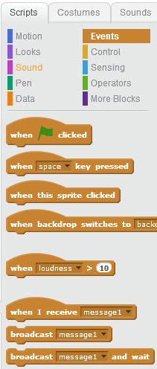
Events
The MOST USEFUL events are
When the Green Flag is clicked
When a keyboard key is pressed
When a sprite is clicked
What is useful for PONG?
(pssst: Events are earlier tests that you learn the outcome of.)

Slide 8
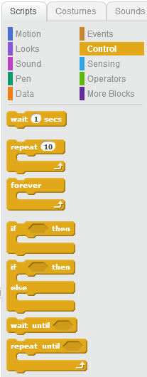
Controlling the actions
You are probably familiar with the basic controls
Wait for some time
Repeat Forever
Repeat a number of times
What is useful for Batty-Pong?
for playing the game?
for starting the game?
for making the bat fly?

Slide 9

Control by Conditional logic Typically test a condition
If <condition> then {
do this stuff
}
If <condition> then {
do this stuff
} else {
do that other stuff
}
Repeat until <condition> {
stuff
}
What is useful for PONG?

Slide 10
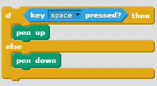
(5 min) Want to try tweaking Rainbow Writer?
I gave you a sneak peek, but here it is again:
You could use the keyboard

Slide 11
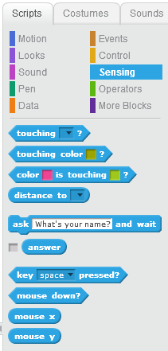
When the is right…
Those angled blocks are “what to test”
You can’t do a game without them
One type of condition is “sensing”
What might be useful for PONG?
(TMTOWTDI – TimToady –
There’s more than one way to do it.

Slide 12
Sensing
What might be important to sense in PONG?
Touching ___?
Key ___ pressed?
Mouse Down?

Slide 13
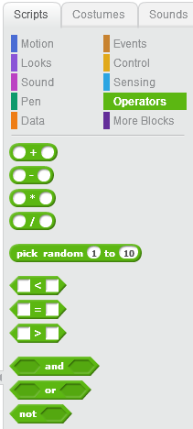
(optional) When the s ARE right
You can make more complex testing with operators (use AND, OR and NOT)
The < = and > operators work on numbers
Do you need these for PONG?

Slide 14
BattyPong – a few quick final words
I want to let you start, but I should give you some tips and
chat about a design plan
Set an appropriate background(*), like WOODS,
Use the bat as your ‘thing that moves around’
The paddle can be decorated for Halloween. What do bats hate? FIRE? Wooden Stakes? Garlic? Have fun!
Think of the bat as who is driving the action.
Stuck? Look at http://scratch.mit.edu/projects/13203931/
* You might use more than one. I had a Title screen costume, the Game Play costume, and a Game Over costume. Alternatively, use a messaging sprite.

Slide 15


Batty-PONG – the plan
Design plan:
1) Get the paddle sliding forever. tip:
2) Get the bat bouncing around. tip: point first, then move forever
3) Add game logic to the bat
tip:
4) Add end-game logic
Checkpoint: http://scratch.mit.edu/projects/13203931/
5) Add a score. I’ll give tips later.
6) Stretch goal: maybe add restart appearance and logic

Slide 16
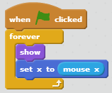
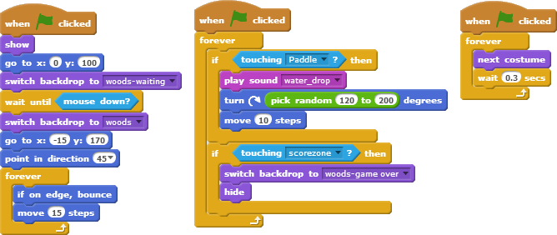
Here are my scripts
On the paddle:
On the Ball
startup code:
Ball gameplay code:
(grey box is for replay only)

Slide 17
Next Class…
Adding a score with variables
Adding Messages to control game state.

Slide 18
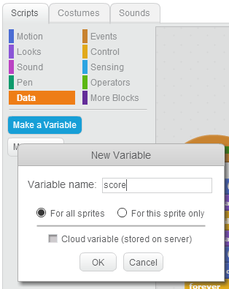
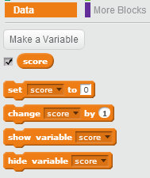
Session 3: Data
You can add data by “variables”
What data might you want in PONG?
Maybe score, high score, timer, ball count
Quick Project: Add the score (bounce count)

Slide 19
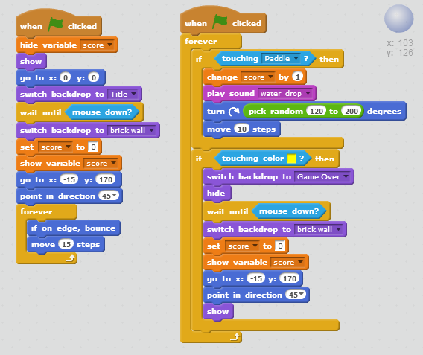
Here’s my score code
Score = times the paddle is hit
All this is on the ball, and nowhere else
Look at the orange blocks.

Slide 20
“Secret” Messages (events to broadcast and receive)
Sprites don’t talk to each other
(think of pong’s ball and paddle)
BUT, you can add your own secret message
Broadcasting and Receiving Messages is better
Could it make PONG better?
The paddle doesn’t know if the ball goes out of bounds. It could disappear or stop moving.
The “game” doesn’t know if it is over. Messages are a pretty good way to tell everything ‘game over’

Slide 21
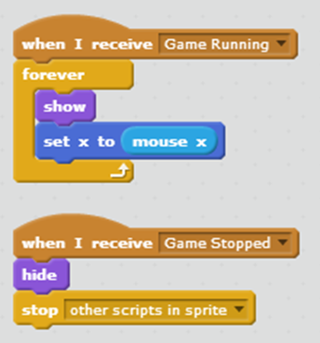
My messages for Pong
I added “Game Running” and “Game Stopped”
What do you think these scripts do (and what sprite are they on?)

Slide 22


Importing
You can import images and sounds
Images will often be bitmaps.
Sounds can be imported into sprites

Slide 23
Advanced features are out there
You might want to add ‘more than one ball’
Cloning can turn Pong into Breakout
http://scratch.mit.edu/projects/10101023/
There’s a special type of data called a ‘list’
I found a quiz (next) that would be better as a list.

Slide 24
Review Quiz!
Ignore question 2, 9
Ugly spelling error in 8, 16
http://scratch.mit.edu/projects/2157361/
Want to change the quiz?

Slide 25
Other resources wiki.scratch.mit.edu/wiki/Alternatives_to_Scratch
UC Berkeley has Snap. Deeper programming
http://byob.berkeley.edu/
Doesn’t require Flash (so works on tablets)
Alice is a program that does better story telling (it has a timeline) and does 3D. It also exposes ‘real’ java programming. To me, the usability was lacking.
Unity3D is a 3d world game engine used by companies and people to make games.

